Slide 1
Representation and Modelling
CS4012

Slide 2
Module Info
Lecturer: Michael English
Contact Details:
  Email: michael.english@ul.ie
  Tel: 061 202772 ext. 2772
  Office: CS Building CS1-024
Lecture Times:
  Monday 11h00 S205
  Thursday 13h00 S206
Tutorials start week 3
Labs: more info later

Slide 3
Module Info
All course material will be available on the web
http://www.csis.ul.ie/

Slide 4
Module Assessment
Mid-term Week 7 (15%)
Assignments (15%)
Final Exam 70%
Attendance will be monitored if…

Slide 5
Module Grading
30% D2
35% D1
40% C3
48% C2
52% C1
56% B3
60% B2
64% B1
72% A2
80% A1

Slide 6
Module Overview
Modelling
  Introduction to modelling
  Types of Models
  Modelling in Software Development
  Data representation modelling
  Using MS Excel for modelling
  Modelling in other domains

Slide 7
Module Overview
Representation
  File Formats
  Text, Graphic, Audio, Video formats
  Compression
  Markup Languages
  Standards

Slide 8
Modelling
What is a model?
  “a simplified illustration of a real situation”, a simplified representation of the relevant entities of some reality and their characteristics
  Abstraction
  Aspects of Interest
  Mapping

Slide 9
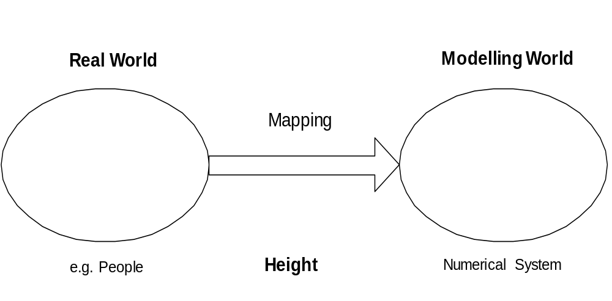
Modelling

Slide 10
Modelling
A model can be
  Descriptive: a design or description of an existing or potential situation
    A house plan
  Prescriptive: provide the best answer to the problem under consideration
    An optimisation problem

Slide 11
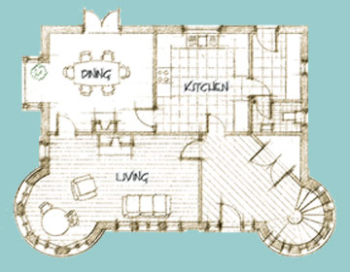
Modelling Example 1

Slide 12
Modelling Example 2
Consider the following problem: I need to travel from UL to UCC for an urgent meeting. The meeting will be held as soon as I arrive at UCC. I have three options:
  Travel by car
  Travel by train
  Travel by plane

Slide 13
Modelling Example 2
This is an optimisation problem
Take the mode of transport that will get me to UCC in the shortest time
Formulate the problem as follows:
Let T1 = time required to travel by car
Let T2 = time required to travel by train
Let T3 = time required to travel by plane

Slide 14
Modelling Example 2
Optimisation: Min(T1,T2,T3)
For i=1 to 3 Min(Ti)
Take into consideration time required to get from initial point to start of transport i (a_i)
Take into consideration time spent on transport i (b_i)
Take into consideration time required to get from end point of transport i to destination (c_i)

Slide 15
Modelling Example 2
Ti=a_i + b_i + c_i
For each mode of transport estimate as accurately as possible a_i, b_i and c_i

Slide 16
Modelling
http://www.newscientist.com/projects/misc/video
http://ie.youtube.com/watch?v=5GOmDdz-9fw
http://ie.youtube.com/watch?v=FT22Nm0voig
http://ie.youtube.com/watch?v=pQt9qCNfqv4&feature=PlayList&p=4138D624E45779B5&index=0&playnext=1

Slide 17
Advantages of Modelling
Achieve a greater understanding of a problem
  An algorithm to calculate income tax due
A model combined with an experienced user can facilitate effective decision making
  Stock trading in financial services – monitoring trends
Cost less
More convenient
They can be reasoned about

Slide 18
Disadvantages/hazards of Modelling
An abstraction
  A simplification of reality
  Output reflects this
  Might not include all possibilities…important variables might have been erroneously excluded
Model may address only one perspective
  A balance sheet for a family business

Slide 19
The Modelling Process (1)
Problem conceptualisation
  Identify model objectives
  Variables to be considered
  Relationships to be considered
Model design
  Planning the content of the model
  Designing the layout
Development of the model
  Resolving the detail

Slide 20
The Modelling Process (2)
Model Automation
  Use of macros in spreadsheets
  Use of CAD tool to generate 3D model of a house
Validation and verification of model
  Validation: Are we building the right model? E.g. Can known results be reproduced?
  Verification: Are we building the model correctly? E.g. Is the internal logic correct?
Model Documentation
  Documentation for users
  Documentation for maintainers
Model ready for use

Slide 21
Essential Features of a Model
Easy to use and maintain
Comprehensively documented
Cost-effective

Slide 22
Summary
Module Information
What is a model? Mapping?
Descriptive or Prescriptive
Modelling Examples
Advantages/Disadvantages of models
Modelling Process
Essential Features of a model

